Slide 1

Cross Validation
Case: smartphone authentication

Slide 2
Problem after we build a model
Data Collection
Data Preprocessing
Feature Extraction and Transformation
Training
Sometimes, we can build several model rather than build a single model
Which model is the best?
Testing
Result Analysis
Notes:
cost ratio of 3 indicates that type-1 error is considered to be 3 times more costly
than type-2 error

Slide 3
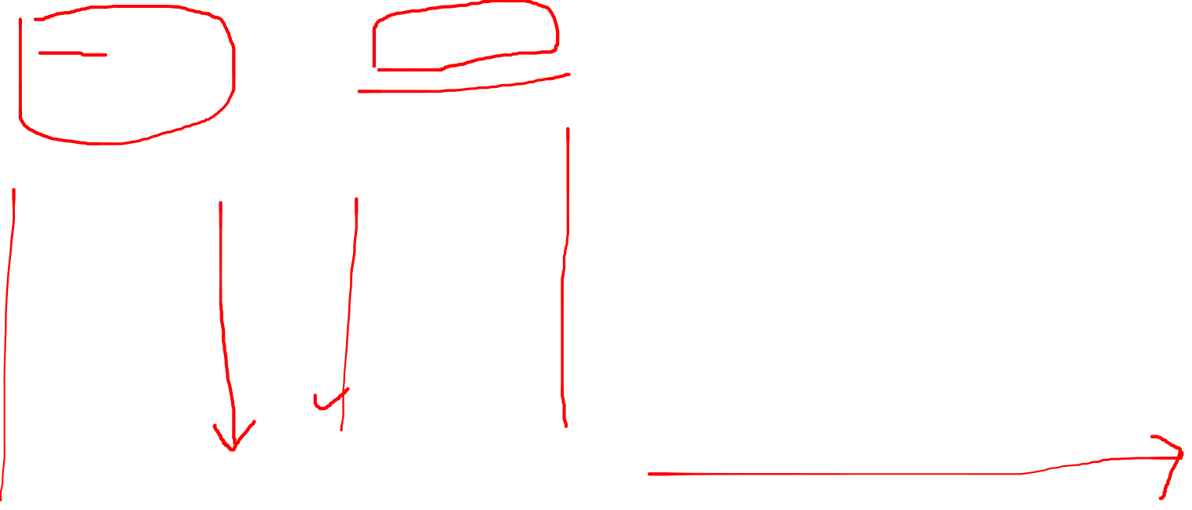
Build several models
Single Model:
Use all train data
Multiple Model
Model 1:
Model 2:
Model 3:
Model 4:
Model 5:
Histogram 1
Histogram 1
Histogram 1
Histogram 1
Histogram 1
Histogram 2
Histogram 2
Histogram 2
Histogram 2
Histogram 2
Histogram 3
Histogram 3
Histogram 3
Histogram 3
Histogram 3
Histogram 4
Histogram 4
Histogram 4
Histogram 4
Histogram 4
Histogram 5
Histogram 5
Histogram 5
Histogram 5
Histogram 5

Slide 4
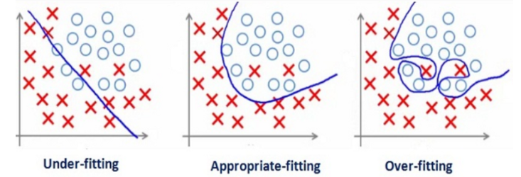
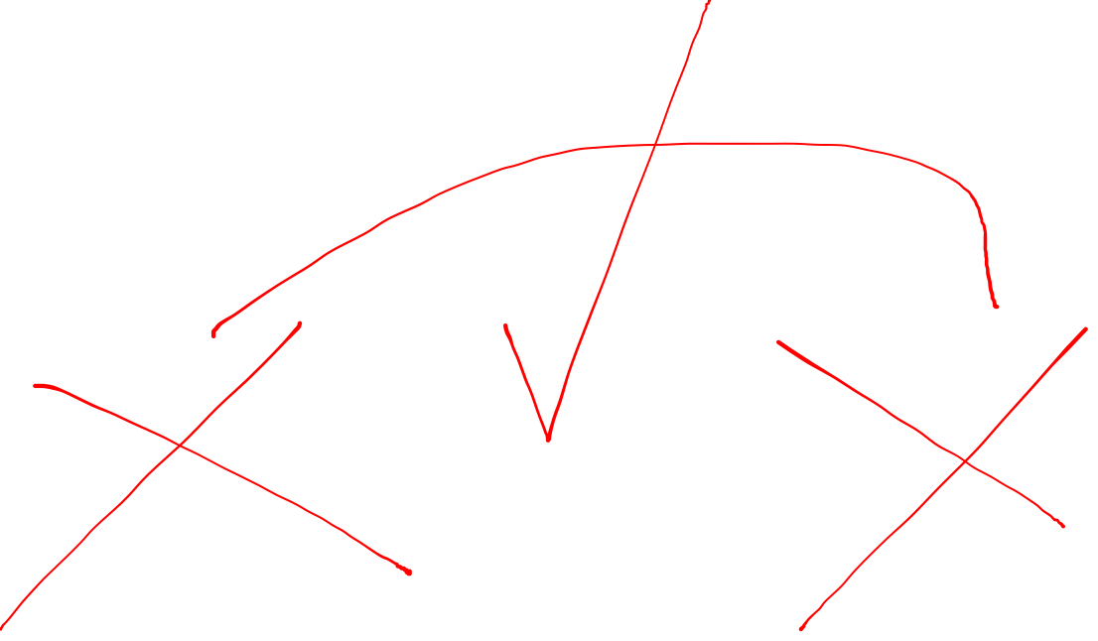
| Overfitting
Why sometimes we don’t need all the data to build a model?
Too much train data may caused Overfitting. Overfitting refers to a model that models the training data too well, resulting in very low training error, but high testing error.
| Underfitting
Too small train data may caused underfitting: Underfitting refers to a model that can not generalize the train data
Notes:
Overfitting happens when a model learns the detail and noise in the training data to the extent that it negatively impacts the performance of the model on new data. This means that the noise or random fluctuations in the training data is picked up and learned as concepts by the model. The problem is that these concepts do not apply to new data and negatively impact the models ability to generalize.
An underfit machine learning model is not a suitable model and will be obvious as it will have poor performance on the training data.

Slide 5
Solution
Do not use all of the train data
Build several model from several combination of train data
Leave a part of train data for validation

Slide 6
Validation: Part of training
Data Collection
Training
Data Preprocessing
Feature Extraction and Transformation
Model 1
Model 2
…
Model n
Training
Validation
Testing
Final Model
Result Analysis
Notes:
cost ratio of 3 indicates that type-1 error is considered to be 3 times more costly
than type-2 error

Slide 7
Validation: pretest
Imagine in a course, we want to pretest our self before the final exam.
Pretest will make sure that our knowledge is ready for final exam.
In data science experiment: validation will make sure that our model is ready for testing
Validation can improve our result.

Slide 8
Introduction to validation data
Samples
Training
Testing
Training
Validation
Remarks: Don’t pick validation data from testing data !
Notes:
cost ratio of 3 indicates that type-1 error is considered to be 3 times more costly
than type-2 error

Slide 9
Build several models: 5 fold cross validation
Multiple Model
Model 1:
Model 2:
Model 3:
Model 4:
Model 5:
Histogram 1
Histogram 1
Histogram 1
Histogram 1
Histogram 2
Train
Histogram 2
Histogram 2
Histogram 2
Histogram 3
Histogram 3
Histogram 3
Histogram 3
Histogram 4
Histogram 4
Histogram 4
Histogram 4
Histogram 5
Histogram 5
Histogram 5
Histogram 5
Validation
Histogram 5
Histogram 4
Histogram 3
Histogram 2
Histogram 1

Slide 10
Validation Result Example
Model | Accuracy
1 | 95 %
2 | 97 %
3 | 90 %
4 | 91 %
5 | 70 %
best model

Slide 11
Build several models: 5 fold cross validation
Multiple Model
best model
Model 1:
Model 2:
Model 3:
Model 4:
Model 5:
Histogram 1
Histogram 1
Histogram 1
Histogram 1
Histogram 2
Train
Histogram 2
Histogram 2
Histogram 2
Histogram 3
Histogram 3
Histogram 3
Histogram 3
Histogram 4
Histogram 4
Histogram 4
Histogram 4
Histogram 5
Histogram 5
Histogram 5
Histogram 5
Validation
Histogram 5
Histogram 4
Histogram 3
Histogram 2
Histogram 1

Slide 12
Other use of validation: choose the best parameter of a classifier
Performance result of a classifier is depend on some parameters.
For example, in Support Vector Machine (SVM) we need to decide C value when build a model.
Different C, different result
We want to find the best C
Use the final model (model with the best C) for testing.
Define C value range we want to test (example : 10⁻³ to 10³)
For each C value, doing 5-Fold Cross Validation and then record the validation accuracy
Select C value with the highest validation accuracy for the final model

Slide 13
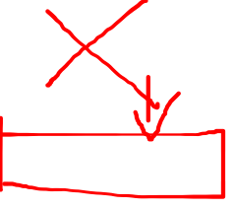

Slide 14
Guided Notes:
Faulty Experiment Design when adjusting classifier parameters
Notes:
cost ratio of 3 indicates that type-1 error is considered to be 3 times more costly
than type-2 error

Slide 15
Question?
Find the faulty part, and design a correct flowchart
Notes:
cost ratio of 3 indicates that type-1 error is considered to be 3 times more costly
than type-2 error

